Slide 1
UML DIAGRAMS
( Unified Modelling Language)

Slide 2
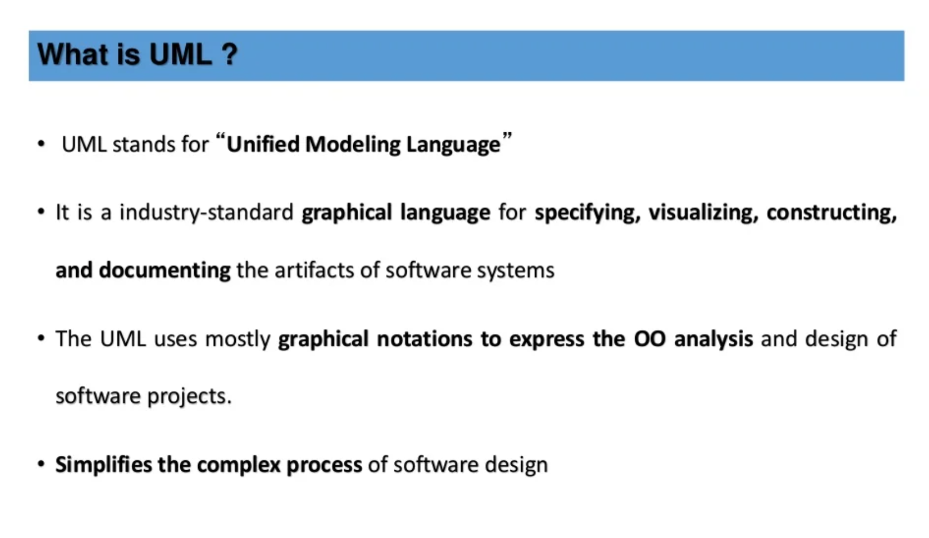
What is UML ?

Slide 3
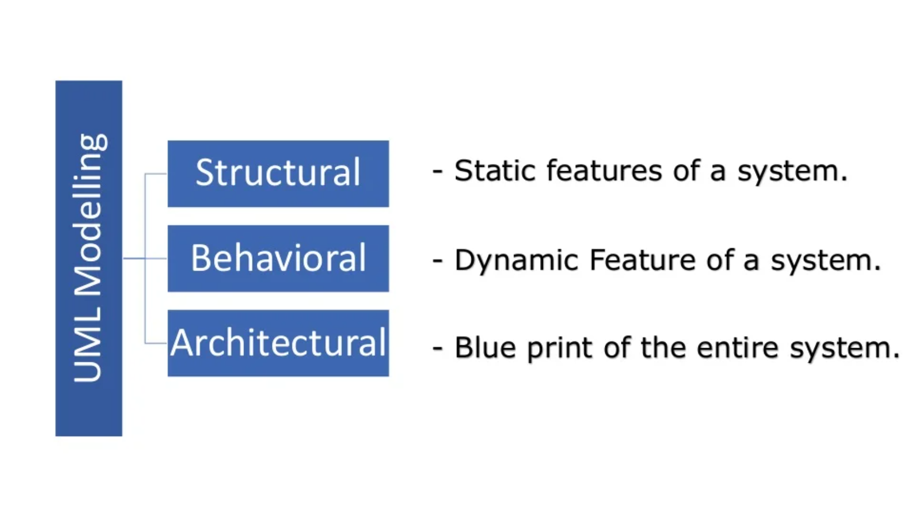
UML Modelling :-

Slide 4
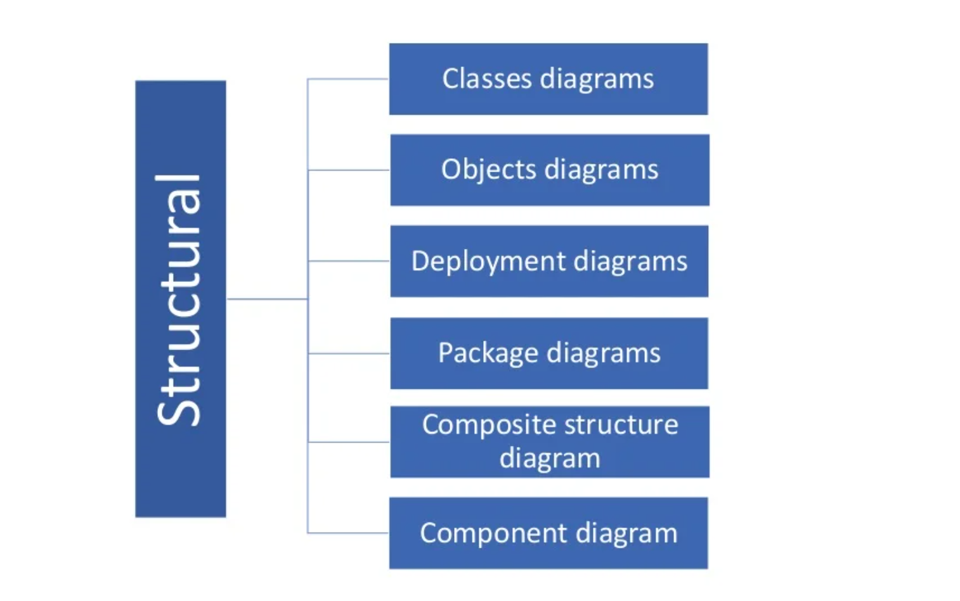
Structural Modeling

Slide 5
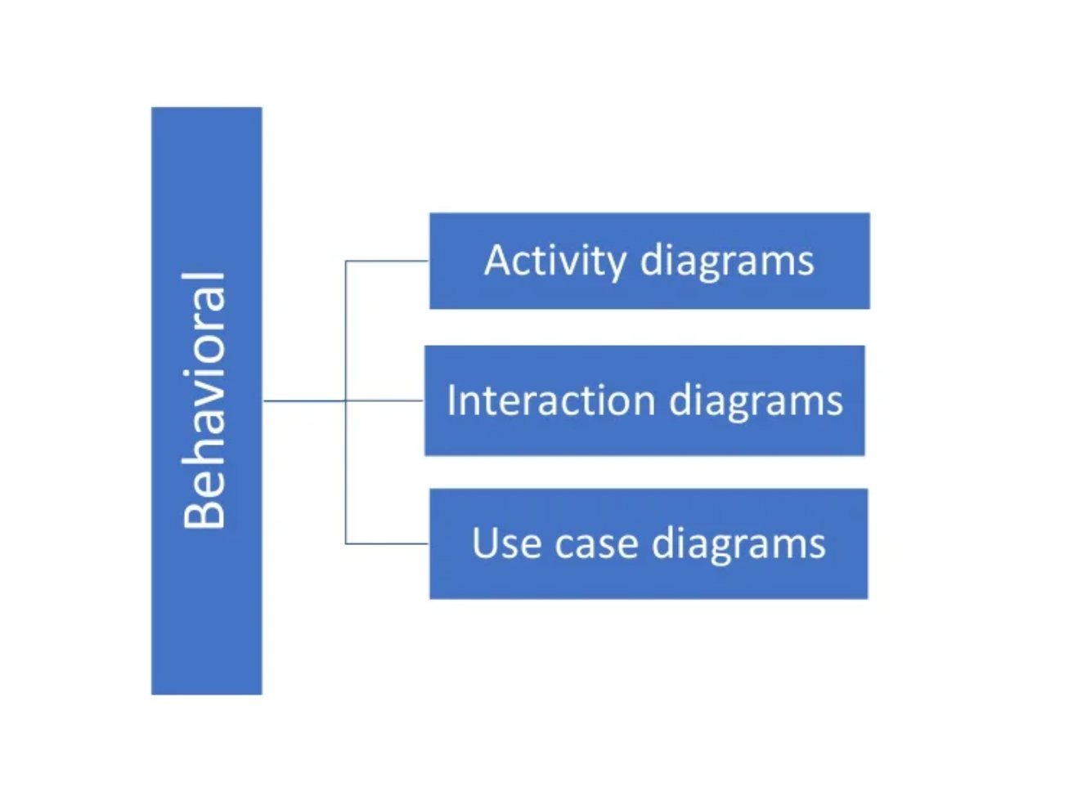
Behavioral

Slide 6
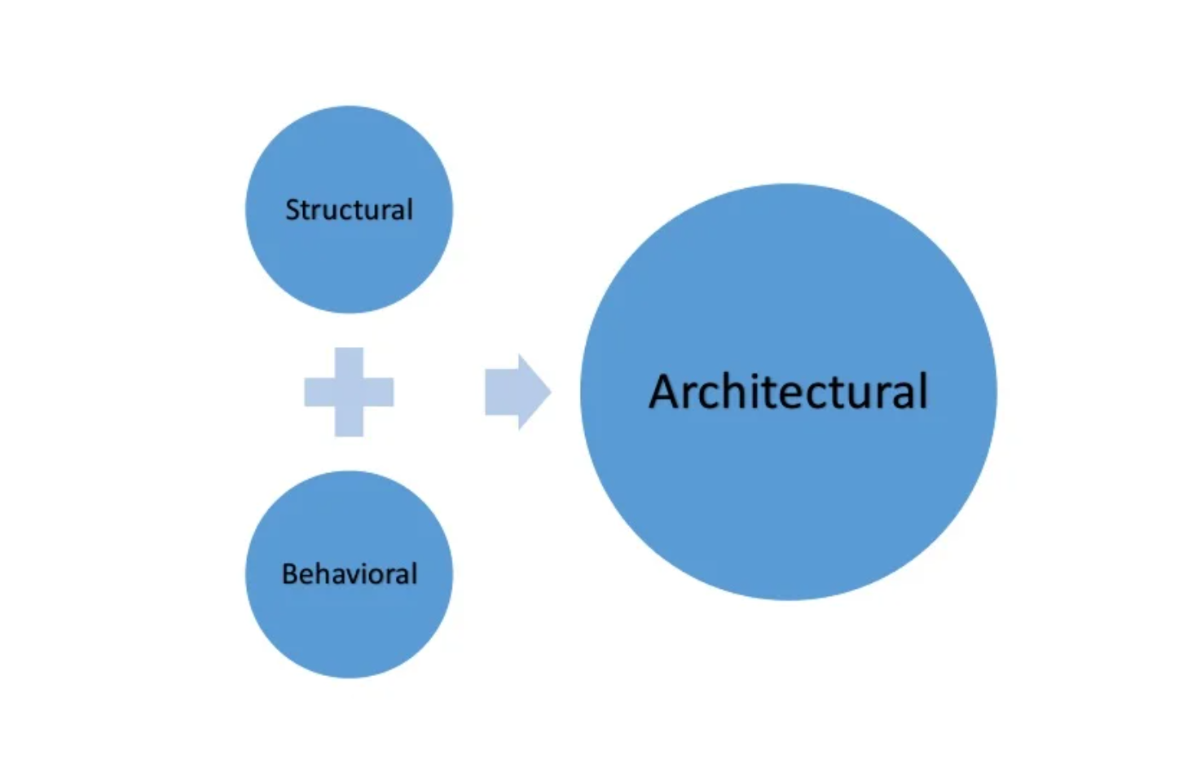
Architectural

Slide 7
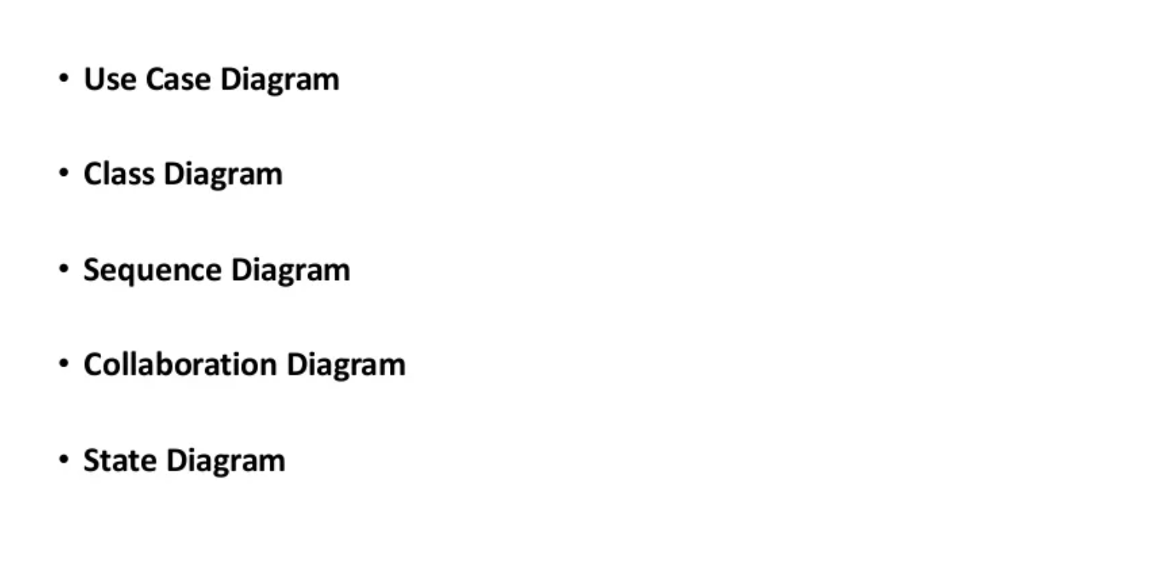
Types of UML Diagram

Slide 8
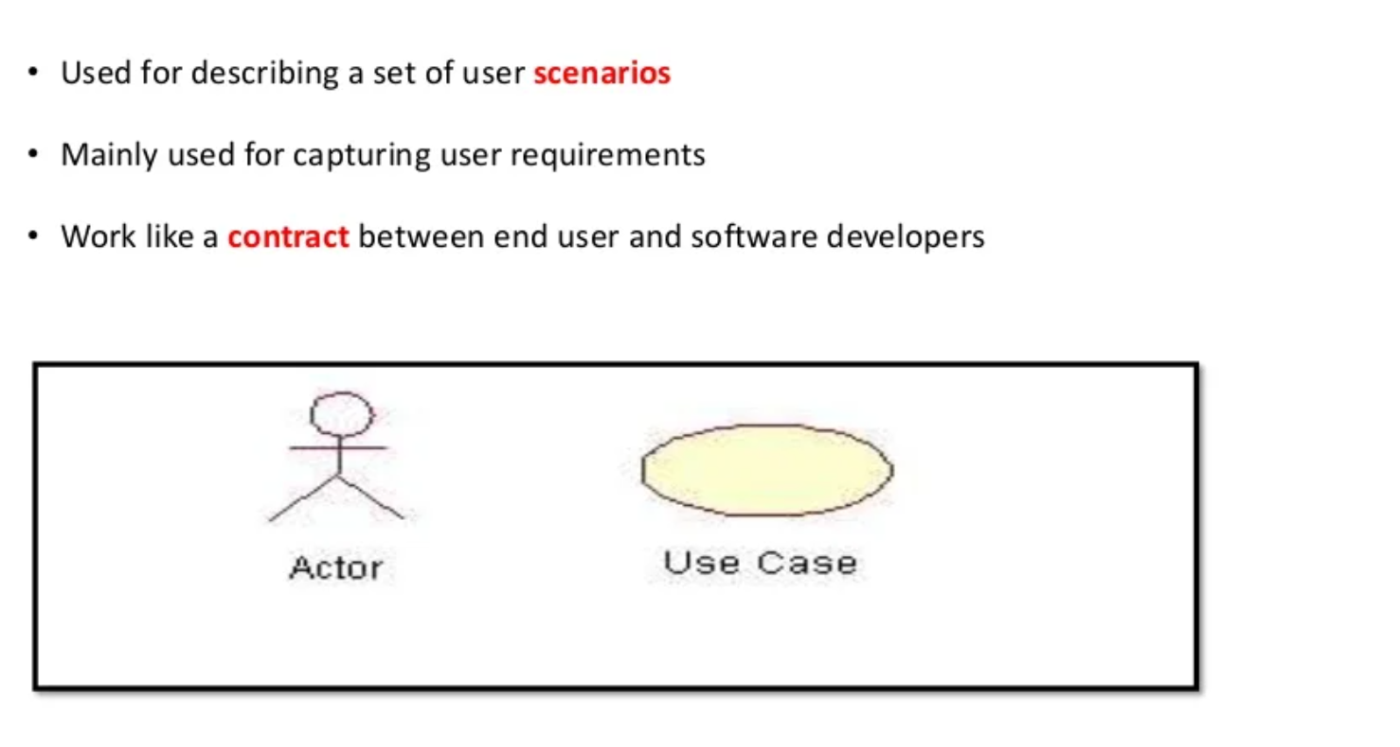
1.Use Case Diagram

Slide 9
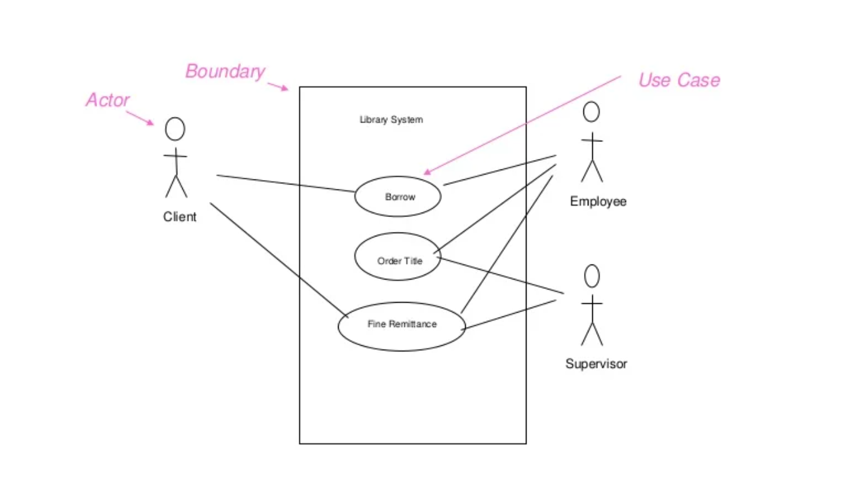
Example of use case diagram

Slide 10
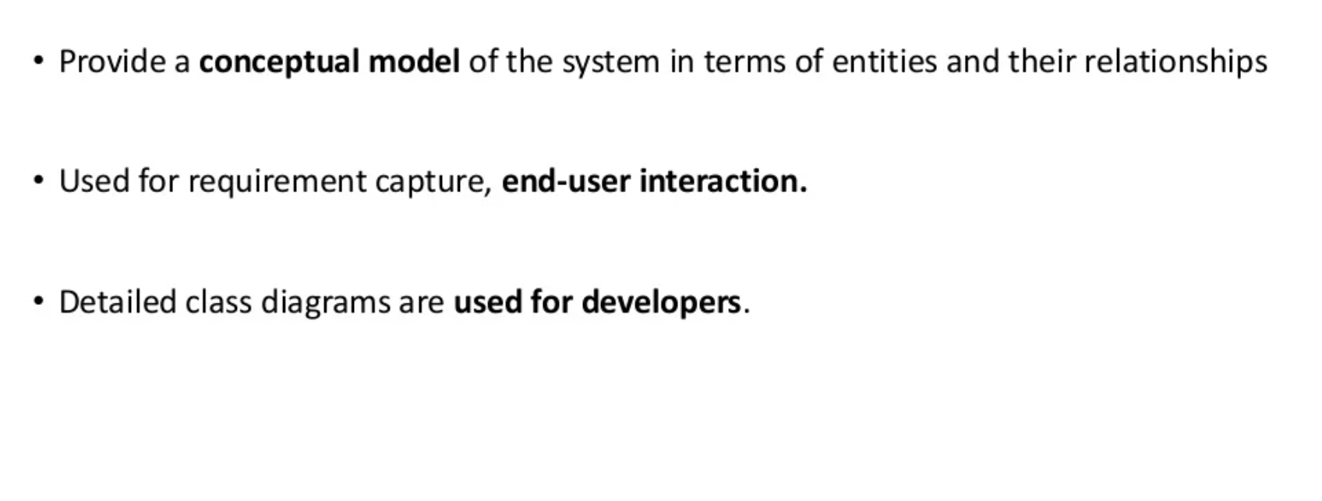
Class Diagram

Slide 11
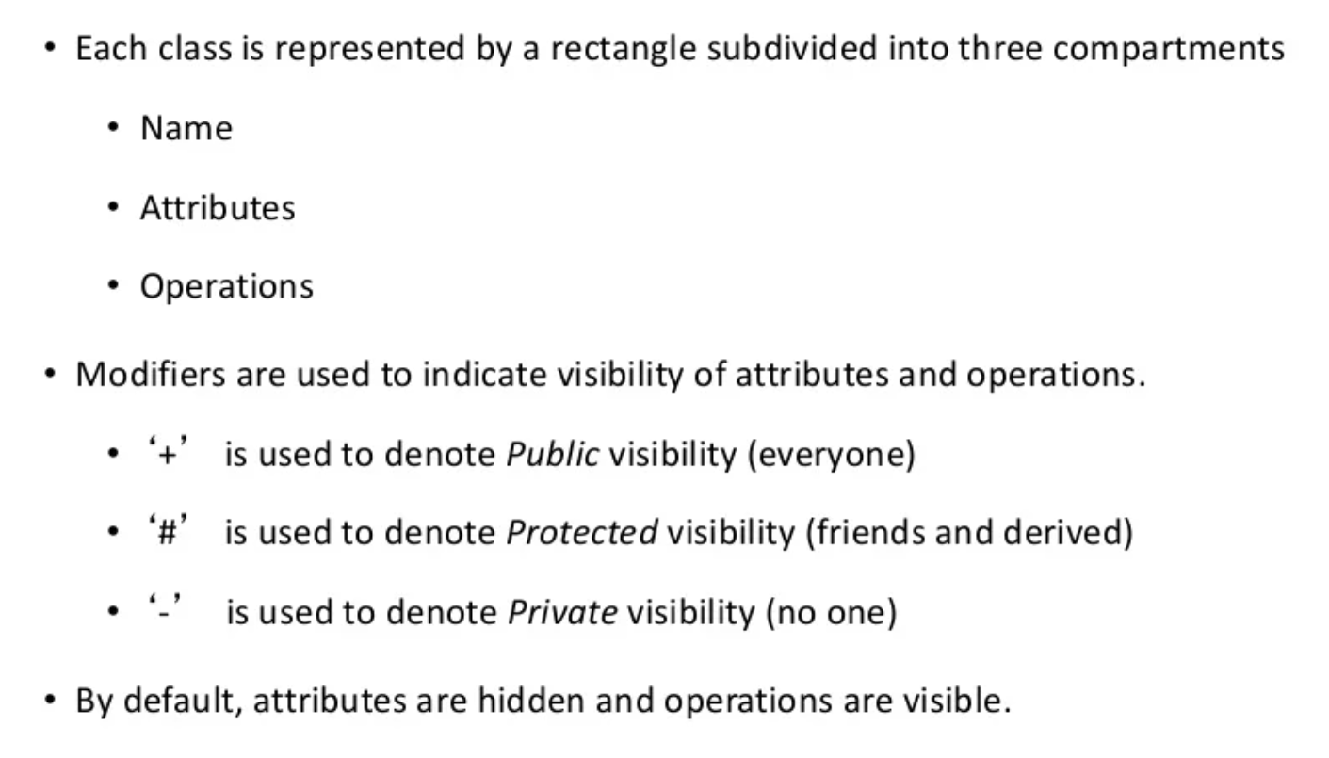
Representation of class

Slide 12
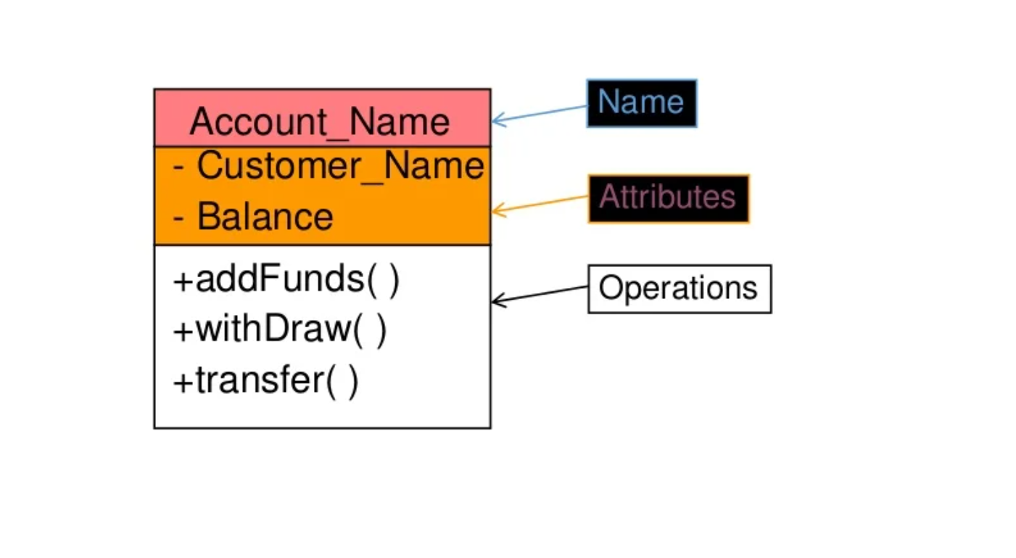
Example of class diagram

Slide 13
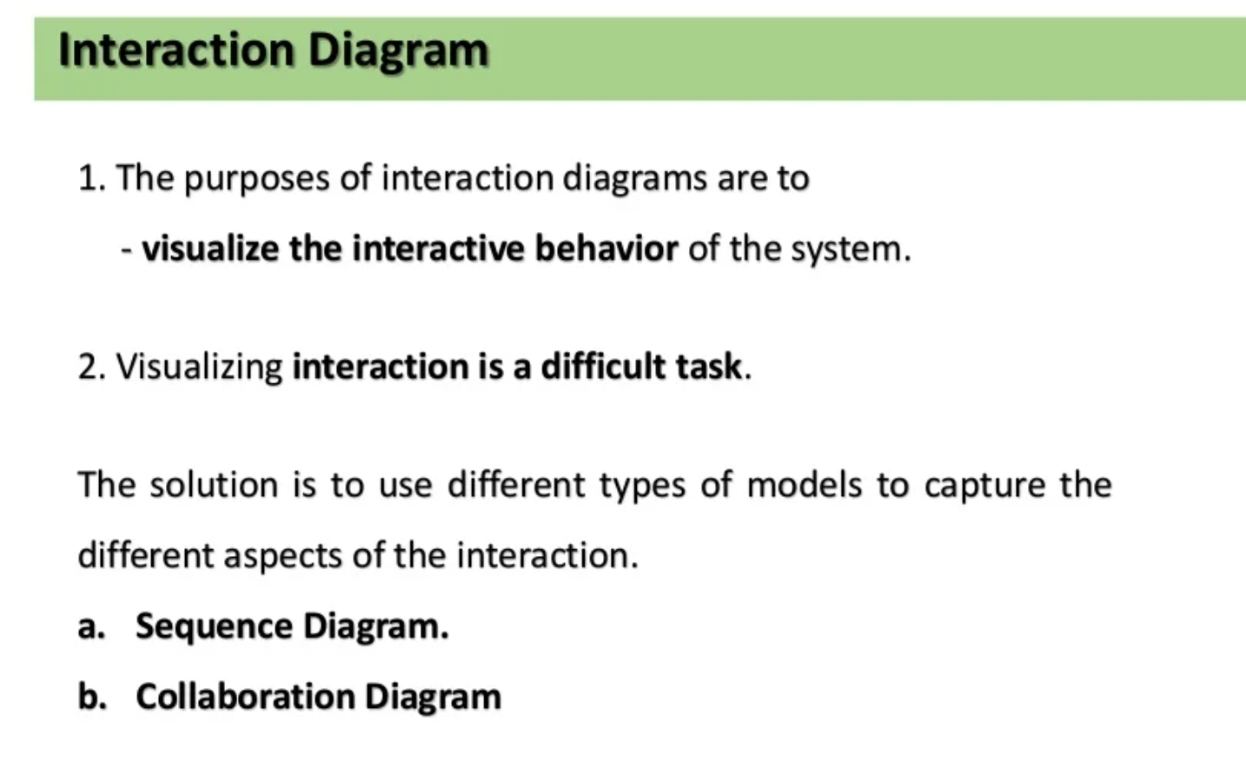
Interaction diagram

Slide 14
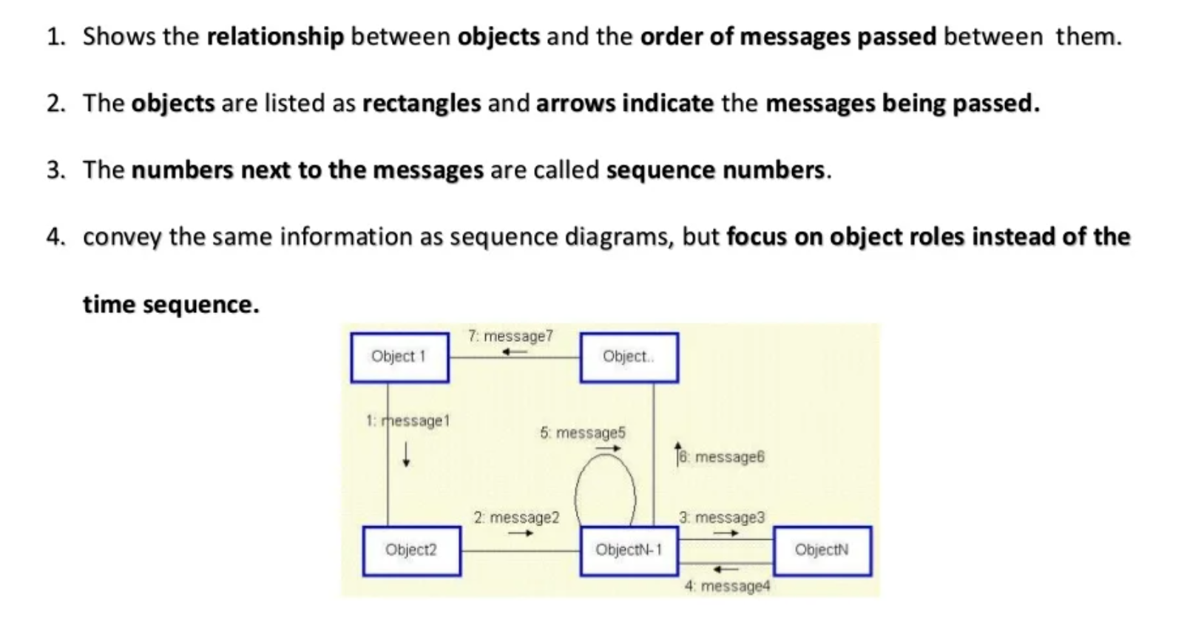
Interaction Diagrams : Collaboration Diagram

Slide 15
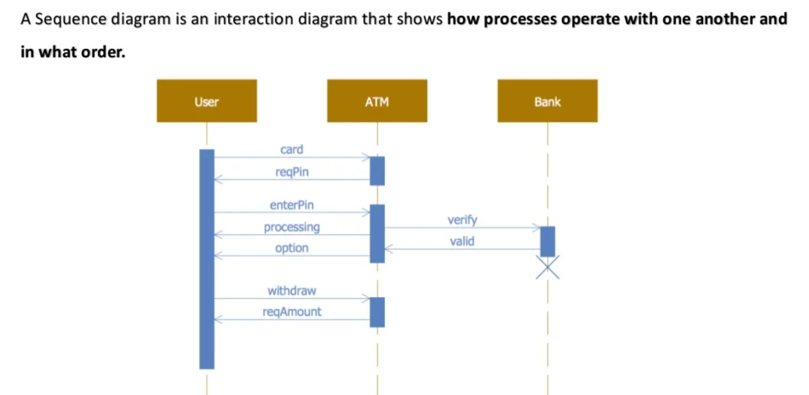
Interaction diagram : Sequence Diagram

Slide 16
THANK-YOU
Name - Aniket

